Slide 1
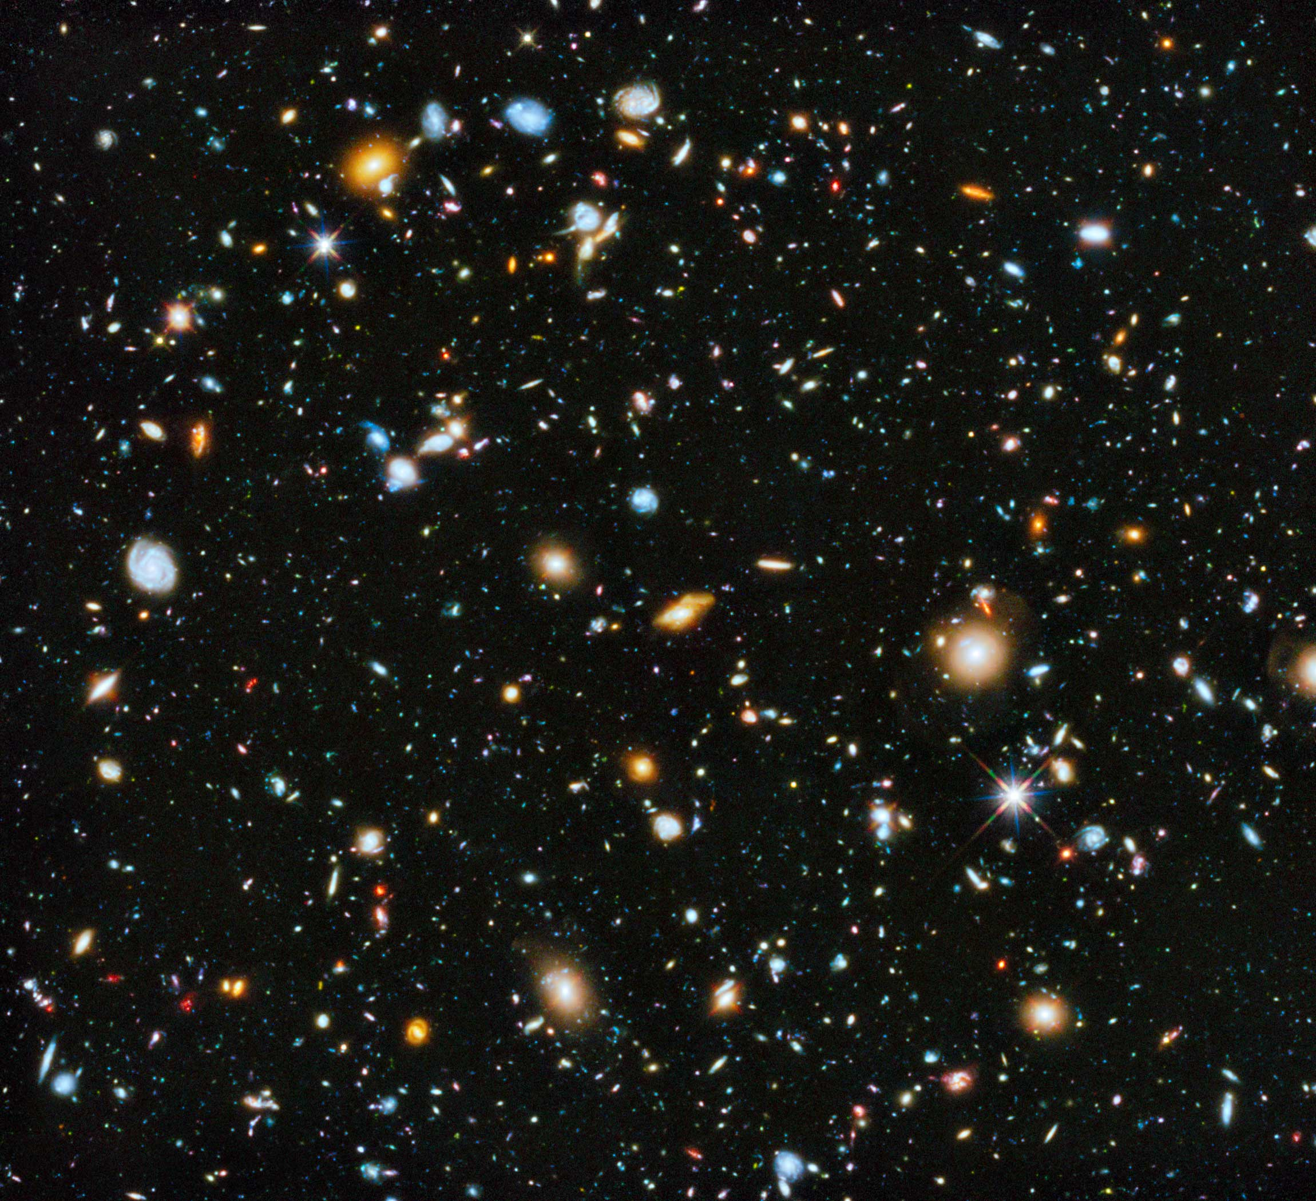
SDSS Classification
Diego McDonald

Slide 2
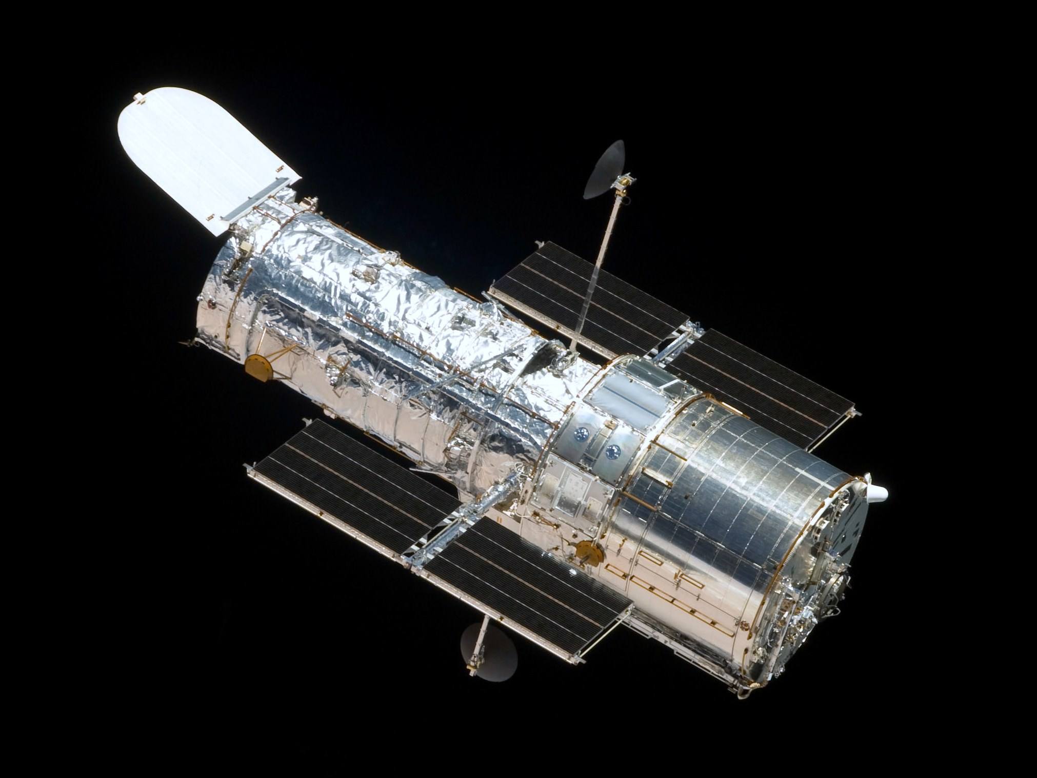
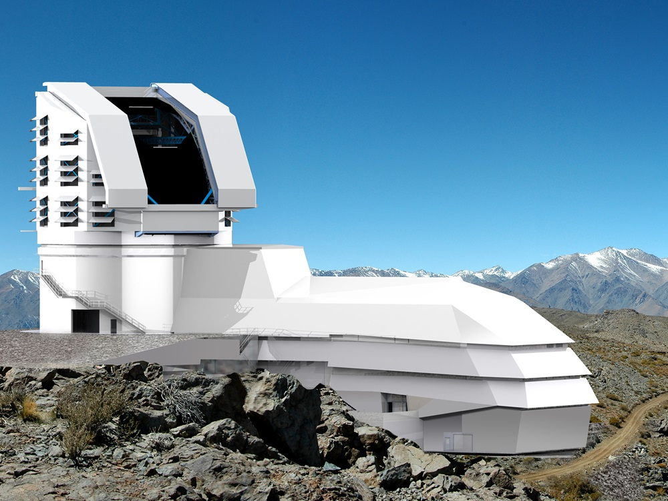
Problem Statement
Notes:
ASTRONOMY BECOMING A DATA SCIENCE DOMINATED FIELD
Changes from Telescopes seeing very dim to seeing very wide.
Left – Hubble Space Telescope
18GB/week average
LSST (https://astronomy.com/news/2017/12/the-lsst-and-big-data-science) and (https://www.lsst.org/about)
20TB processed and stored each night
Planned to deliver over 500 PetaBytes

Slide 3
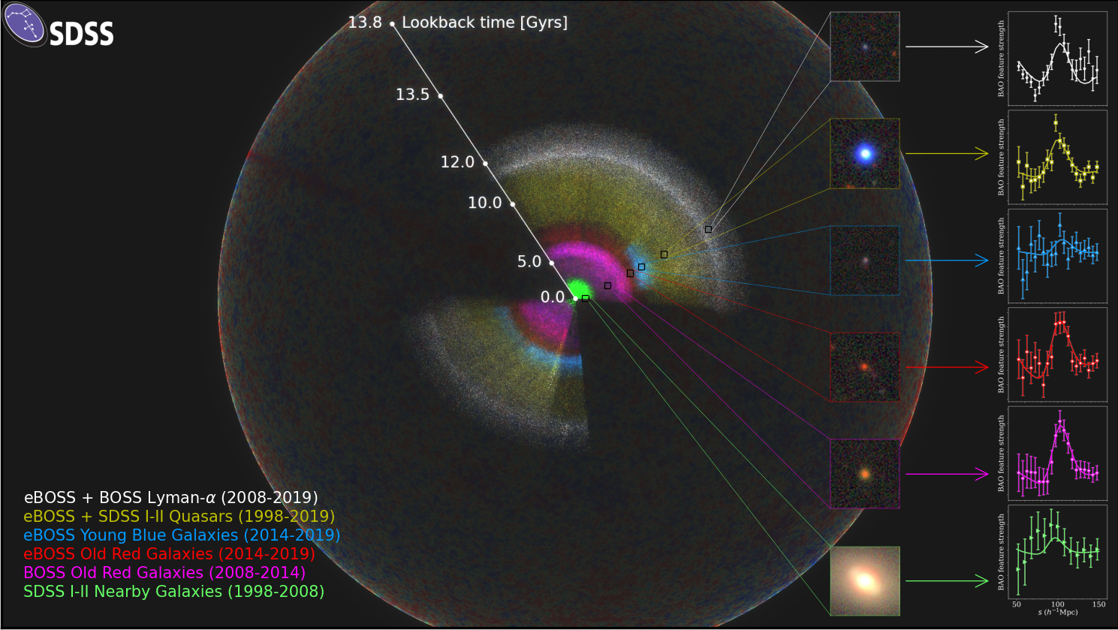
Objective
Notes:
SDSS
Lots to look at
Most important features
Each point is an observation
Each color is how far back in time we are looking
The further back we look, we are able to see more “creation” → younger galaxies
Data
230 million objects
>270 TB

Slide 4
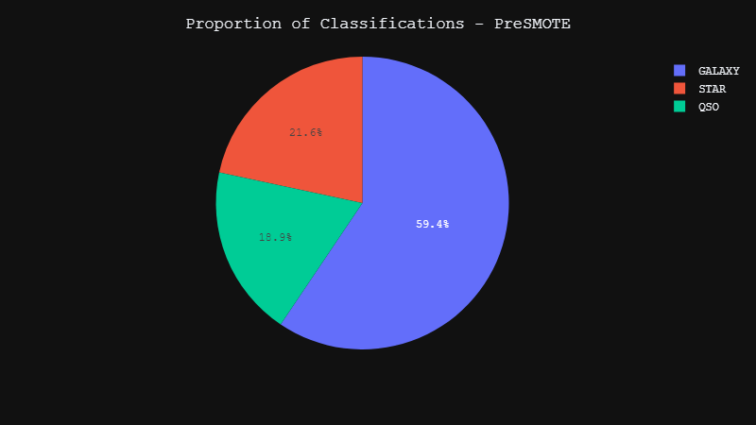
Datasets
Notes:
Working with a subset
~100,000 records → 100,000 objects
Classification proportions
~60% galaxies
~20% each for star and QSO respectively

Slide 5
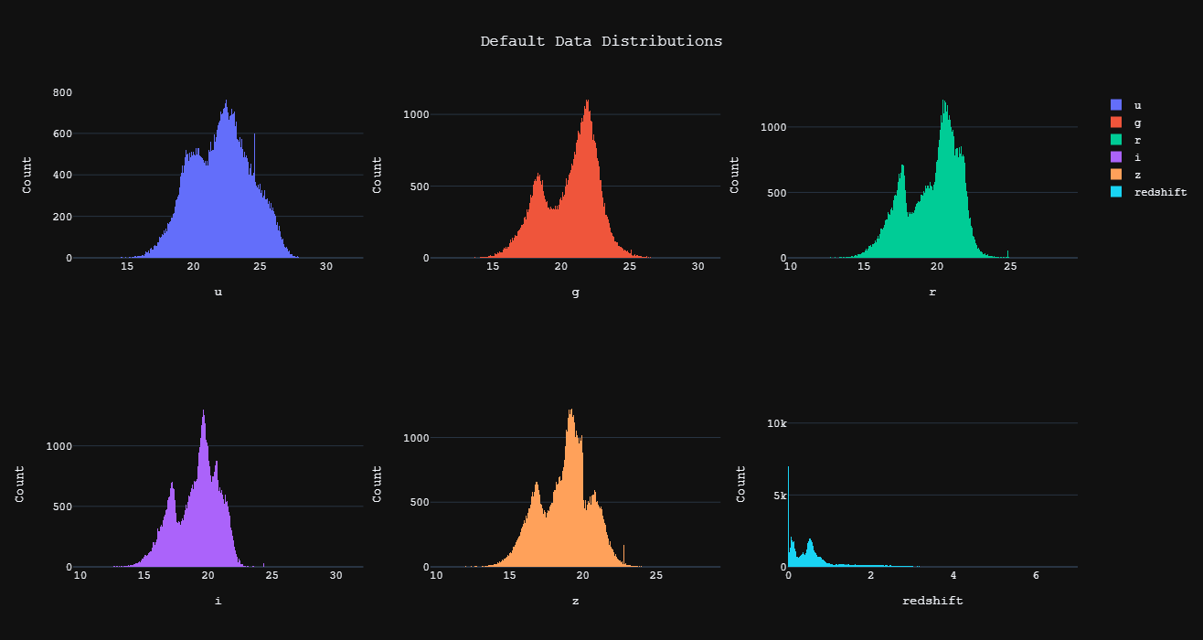
Datasets
Notes:
Displayed:
Distributions of selected features
U G R I Z → measures brightness in a specific wavelength
Redshift → how much wavelength has shifted from first emission to when we detected it
Correlates with distance away from us and age of object.
Multi-Modal distributions → evidence of clustering

Slide 6
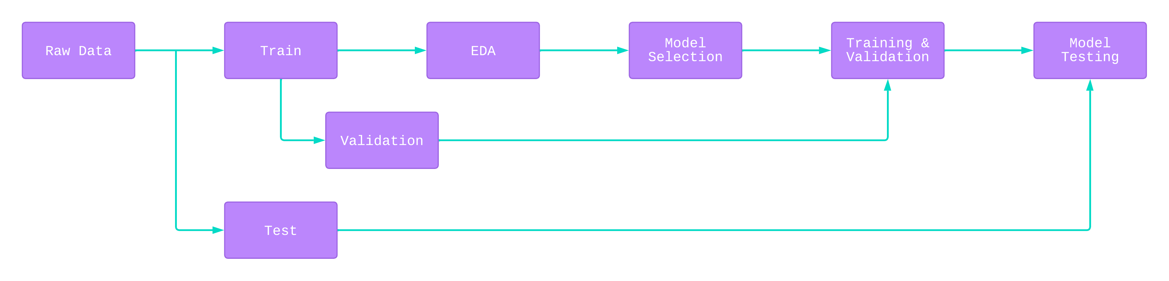
Block Diagram
Notes:
Simple block diagram
Model Selection → Validation → Testing repeated on ~6 models

Slide 7
Methodology
Logistic Regression
Decision Tree
Gradient Boosted Descent
Random Forest
Support Vector Machine
K-Nearest Neighbors
Neural Network (???)
Notes:
Basic models to start with
Some parametric
Some non parametric
Havent gotten to Neural Networks yet
But planning to

Slide 8
Baseline (Success or Failure)
Notes:
Baseline →Accuracy above 60%, since guessing “GALAXY” for every object gives 60% accuracy.

Slide 9
Evaluation
Model | Accuracy | Recall | Precision | FN Rate | F1 Score | ROC AUC OVR | ROC AUC OVO
LogisticRegression | 0.950 | 0.950 | 0.951 | 0.050 | 0.950 | 0.988 | 0.990
DecisionTreeClassifier | 0.960 | 0.960 | 0.961 | 0.040 | 0.960 | 0.969 | 0.970
GradientBoostingClassifier | 0.965 | 0.965 | 0.965 | 0.035 | 0.965 | 0.994 | 0.994
RandomForestClassifier | 0.975 | 0.975 | 0.975 | 0.025 | 0.975 | 0.992 | 0.992
SVC | 0.968 | 0.968 | 0.968 | 0.032 | 0.968 | 0.991 | 0.993
KNeighborsClassifier | 0.958 | 0.958 | 0.959 | 0.042 | 0.958 | 0.983 | 0.984

Slide 10
Questions?

